Slide 1
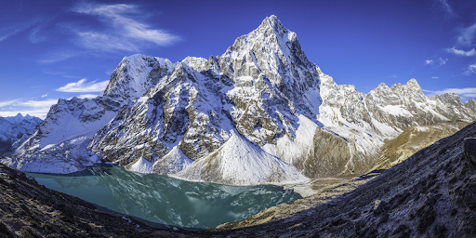
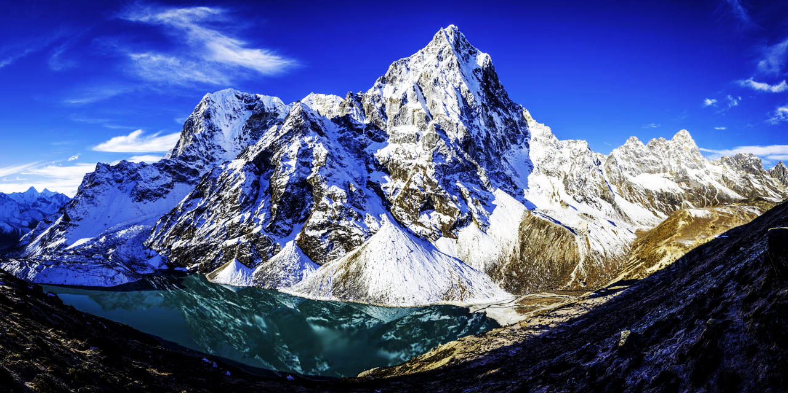
AR Peak Finder Presentation
Carson Stevens, Cameron Do, Brooke Suesser, Ben Brokaw
Notes:
Team members should spend equal time presenting.
Your presentation should cover:
Your topic, and the aims of your project (1 minute)
Previous work (30 seconds)
Technical approach (2 minutes)
Experiments and results (1 minute)
Achievements, limitations, possible future work (30 seconds)
The night before your presentation upload your Final Presentation (SLIDES) to Canvas (PPT,PPTX,ODP, or PDF only).. I will put them on the podium computer so that all presentations are ready to go, but you are welcome to use your own computer to present (especially if you have a demo) -- you will just need to set up during the previous presenter's Q/A time.
Each presentation day be sure to arrive sharply by the start of class, not only if you're presenting, but also to ensure you don't interrupt the first presenter's talk.
Brooke

Slide 2
Outline
Objective
Previous Work
Technical Approach
Homography 3D-2D
Faster-RCNN
Experiments/Progress
Limitations
Future Work
Questions
Notes:
I’ll skip if we run out of time

Slide 3
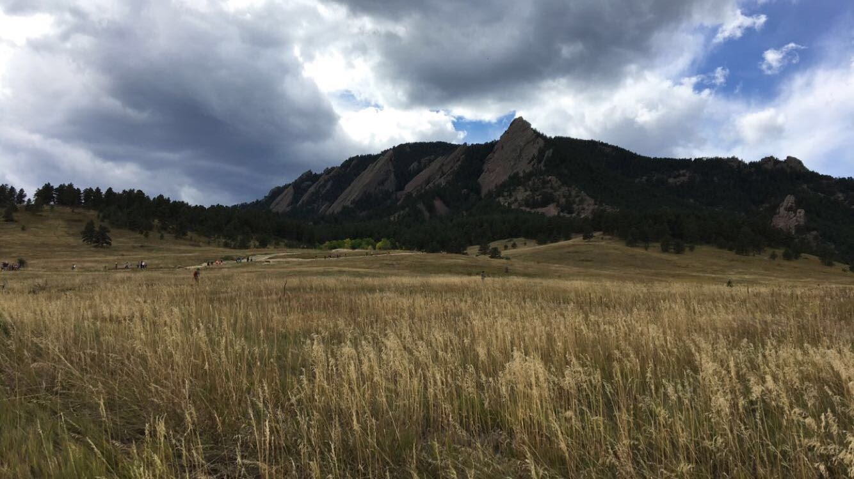
Objective
Given an input photo, project mountain names onto the mountain peaks that are in visible line of sight.
1st Flatiron
2nd Flatiron
Notes:
Brooke
Aims:Quickly and accurately identify peaks
EXIF information which gives the team important information such as latitude, longitude, and heading, as well as focal length, sensor dimensions, camera orientation

Slide 4
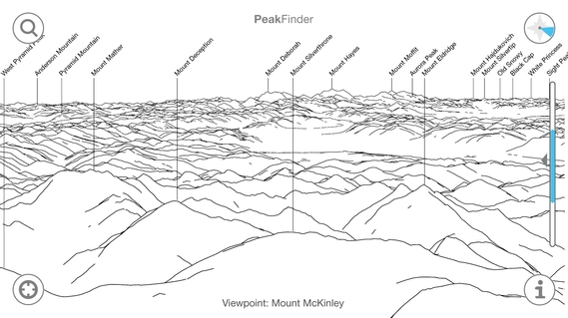
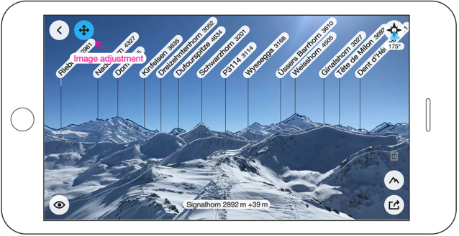
Previous work - Peak Identification
Methods:
Image processing [1]
Elevation mapping for local peaks [1]
Line of sight from longitude, latitude and heading [2]
GPS database, fully offline [3]
Notes:
Brooke
Image processing can be unreliable due to weather conditions, time of day and difficulty isolating the peaks in the image

Slide 5
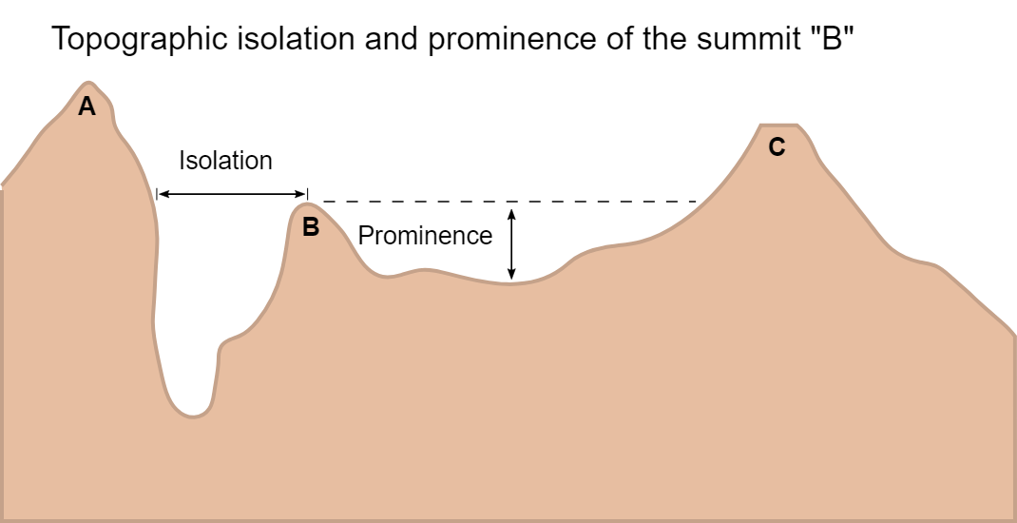
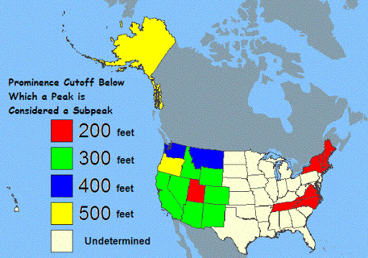
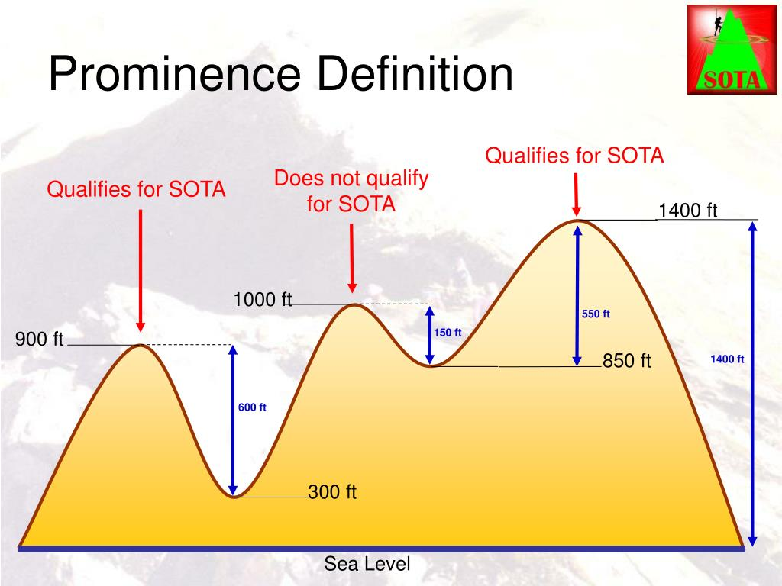
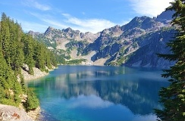
Peak Descrimination
Notes:
CITE IMAGES

Slide 6
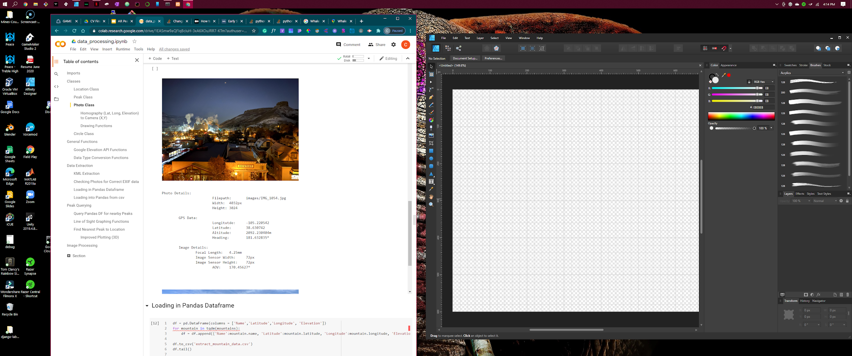
2 Prong Technical Approach
Homography and Faster-RCNN
AOV, 𝛉

Slide 7
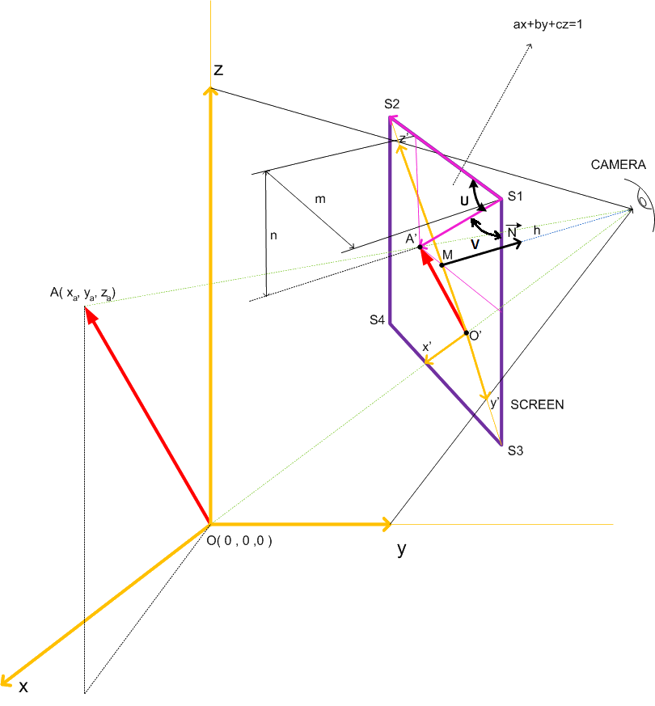
Homography
3D to 2D
Filtering using AOV
A common technique in computer graphics involving a virtual camera

Slide 8


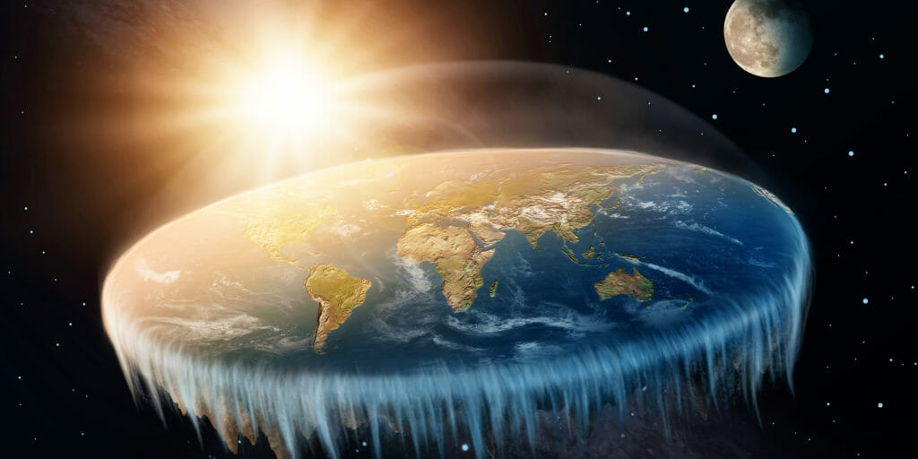
Haversine Solution
Homography alone isn’t good enough
Map points to Cartesian
Notes:
The haversine formula determines the great-circle distance between two points on a sphere given their longitudes and latitudes. Important in navigation, it is a special case of a more general formula in spherical trigonometry, the law of haversines, that relates the sides and angles of spherical triangles.

Slide 9
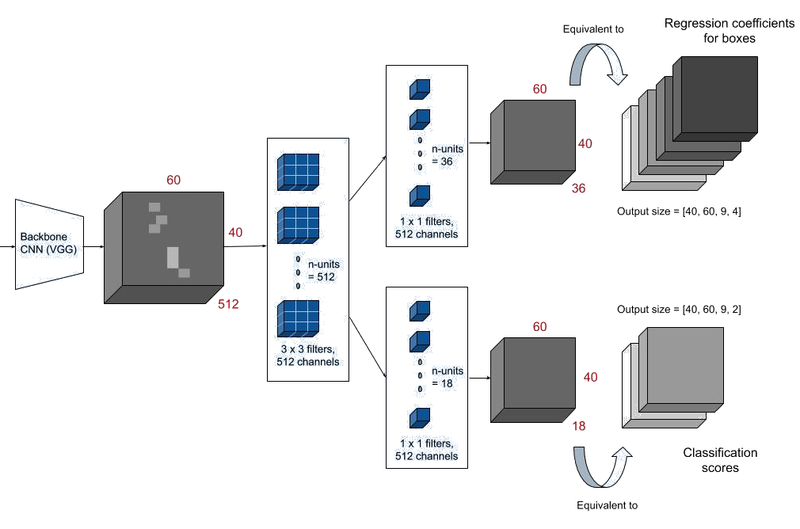
Faster-RCNN

Slide 10
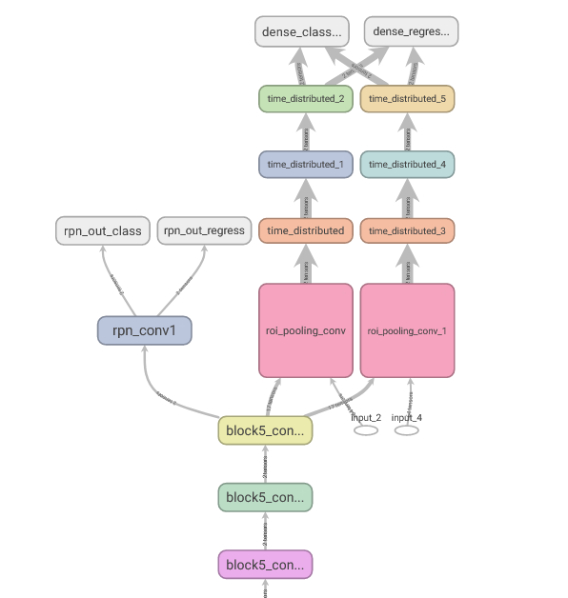
Final Pipeline
Extract EXIF
Query Peak Database for Nearby Peaks
Filter with homography and line of sight
Find peaks in image using Faster-RCNN
Label peaks found in image
Notes:
BEN START

Slide 11
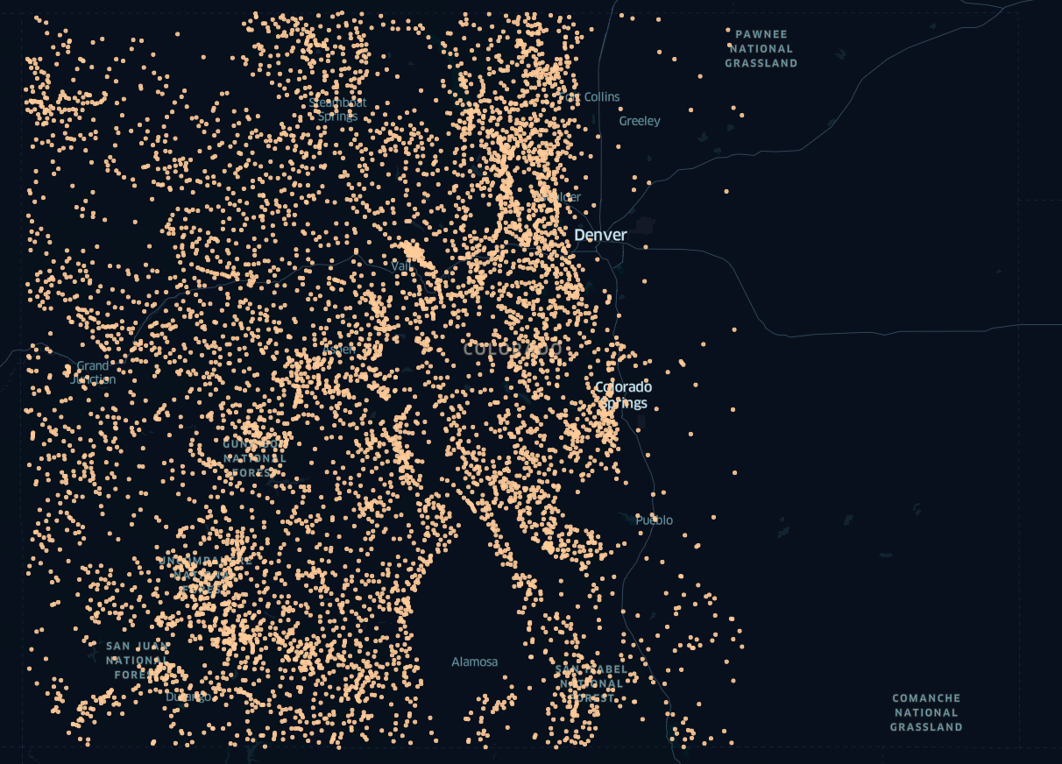
Current Progress: Data Acquisition
Collected Dataset of Colorado Peaks
Over 7000 unique data points
Extract EXIF data from input images
Latitude, Longitude, Elevation, Heading, etc
Identify Nearest Peaks to Image Location
Notes:
Mention Haversine (Earth’s curve)

Slide 12
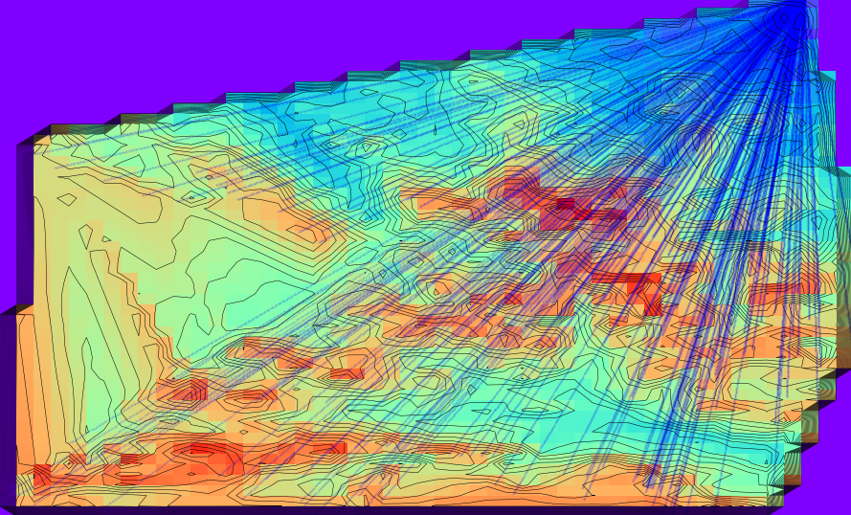
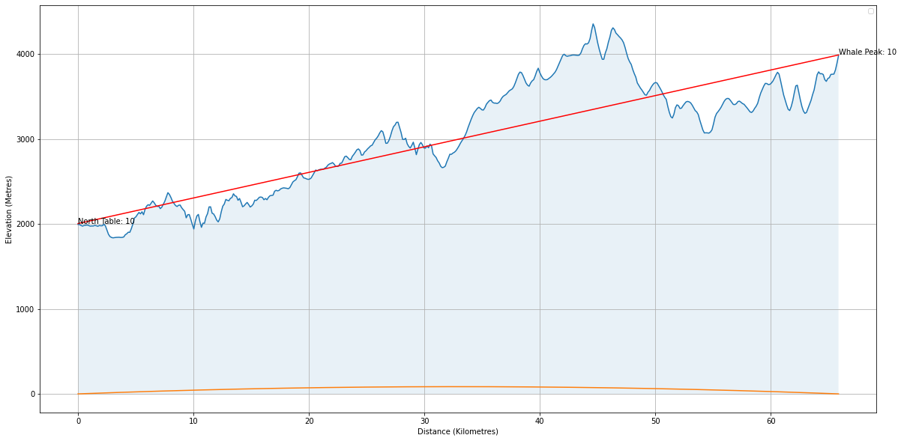
Progress so far: Line of Sight
Calculate Line of Sight
Incorporating azimuth angles
Project Line of Sight onto Topography
Identify Intersections with Terrain
Define Visibility

Slide 13
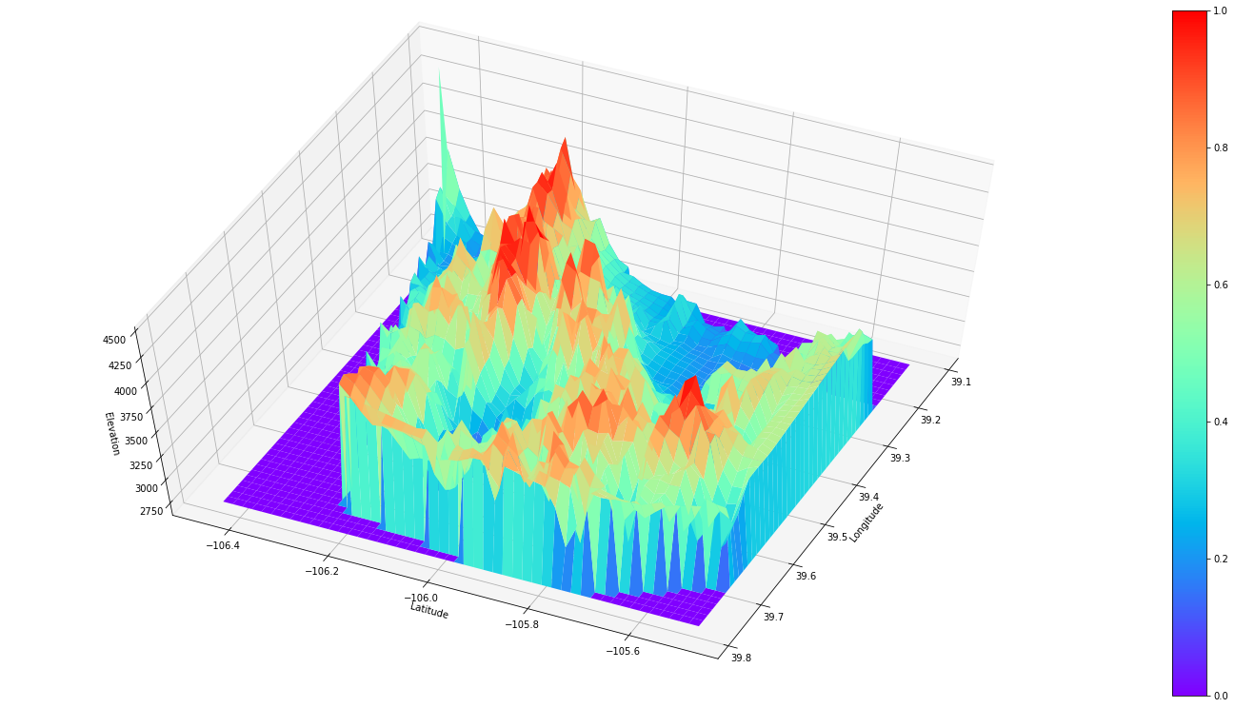
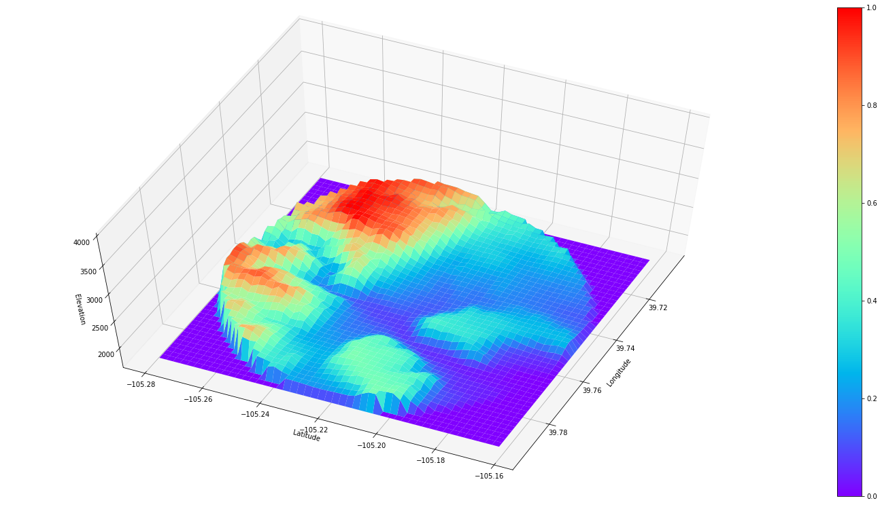
Progress so Far: Terrain Projection
Project Terrain Data to Image Frame
Using Homography
Identify Candidate Peaks
Extract Relative Apparent Locations
Notes:
10km with 0.5deg spacing

Slide 14
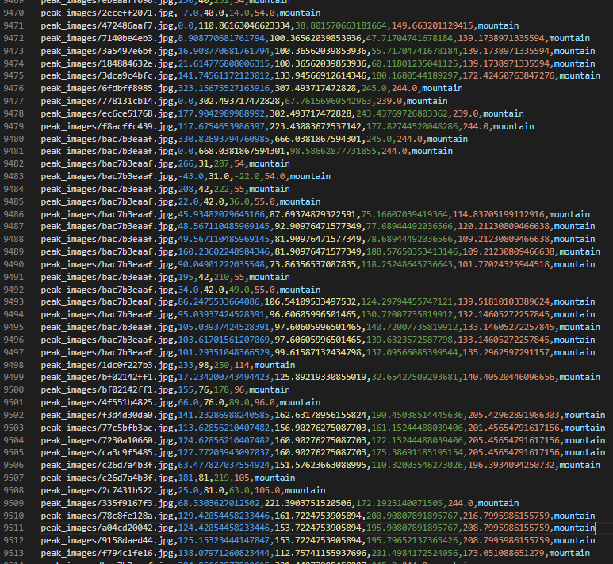
Progress so far: Visual Peak Location
Edge Detection Failed
ML solution progress stalled due to lack of data
Dataset Creation:
Hand-Labeled Over 1,000 Images
Almost 10,000 samples after augmentation
Model
FR-CNN architecture chosen
Training Pipeline Completed

Slide 15
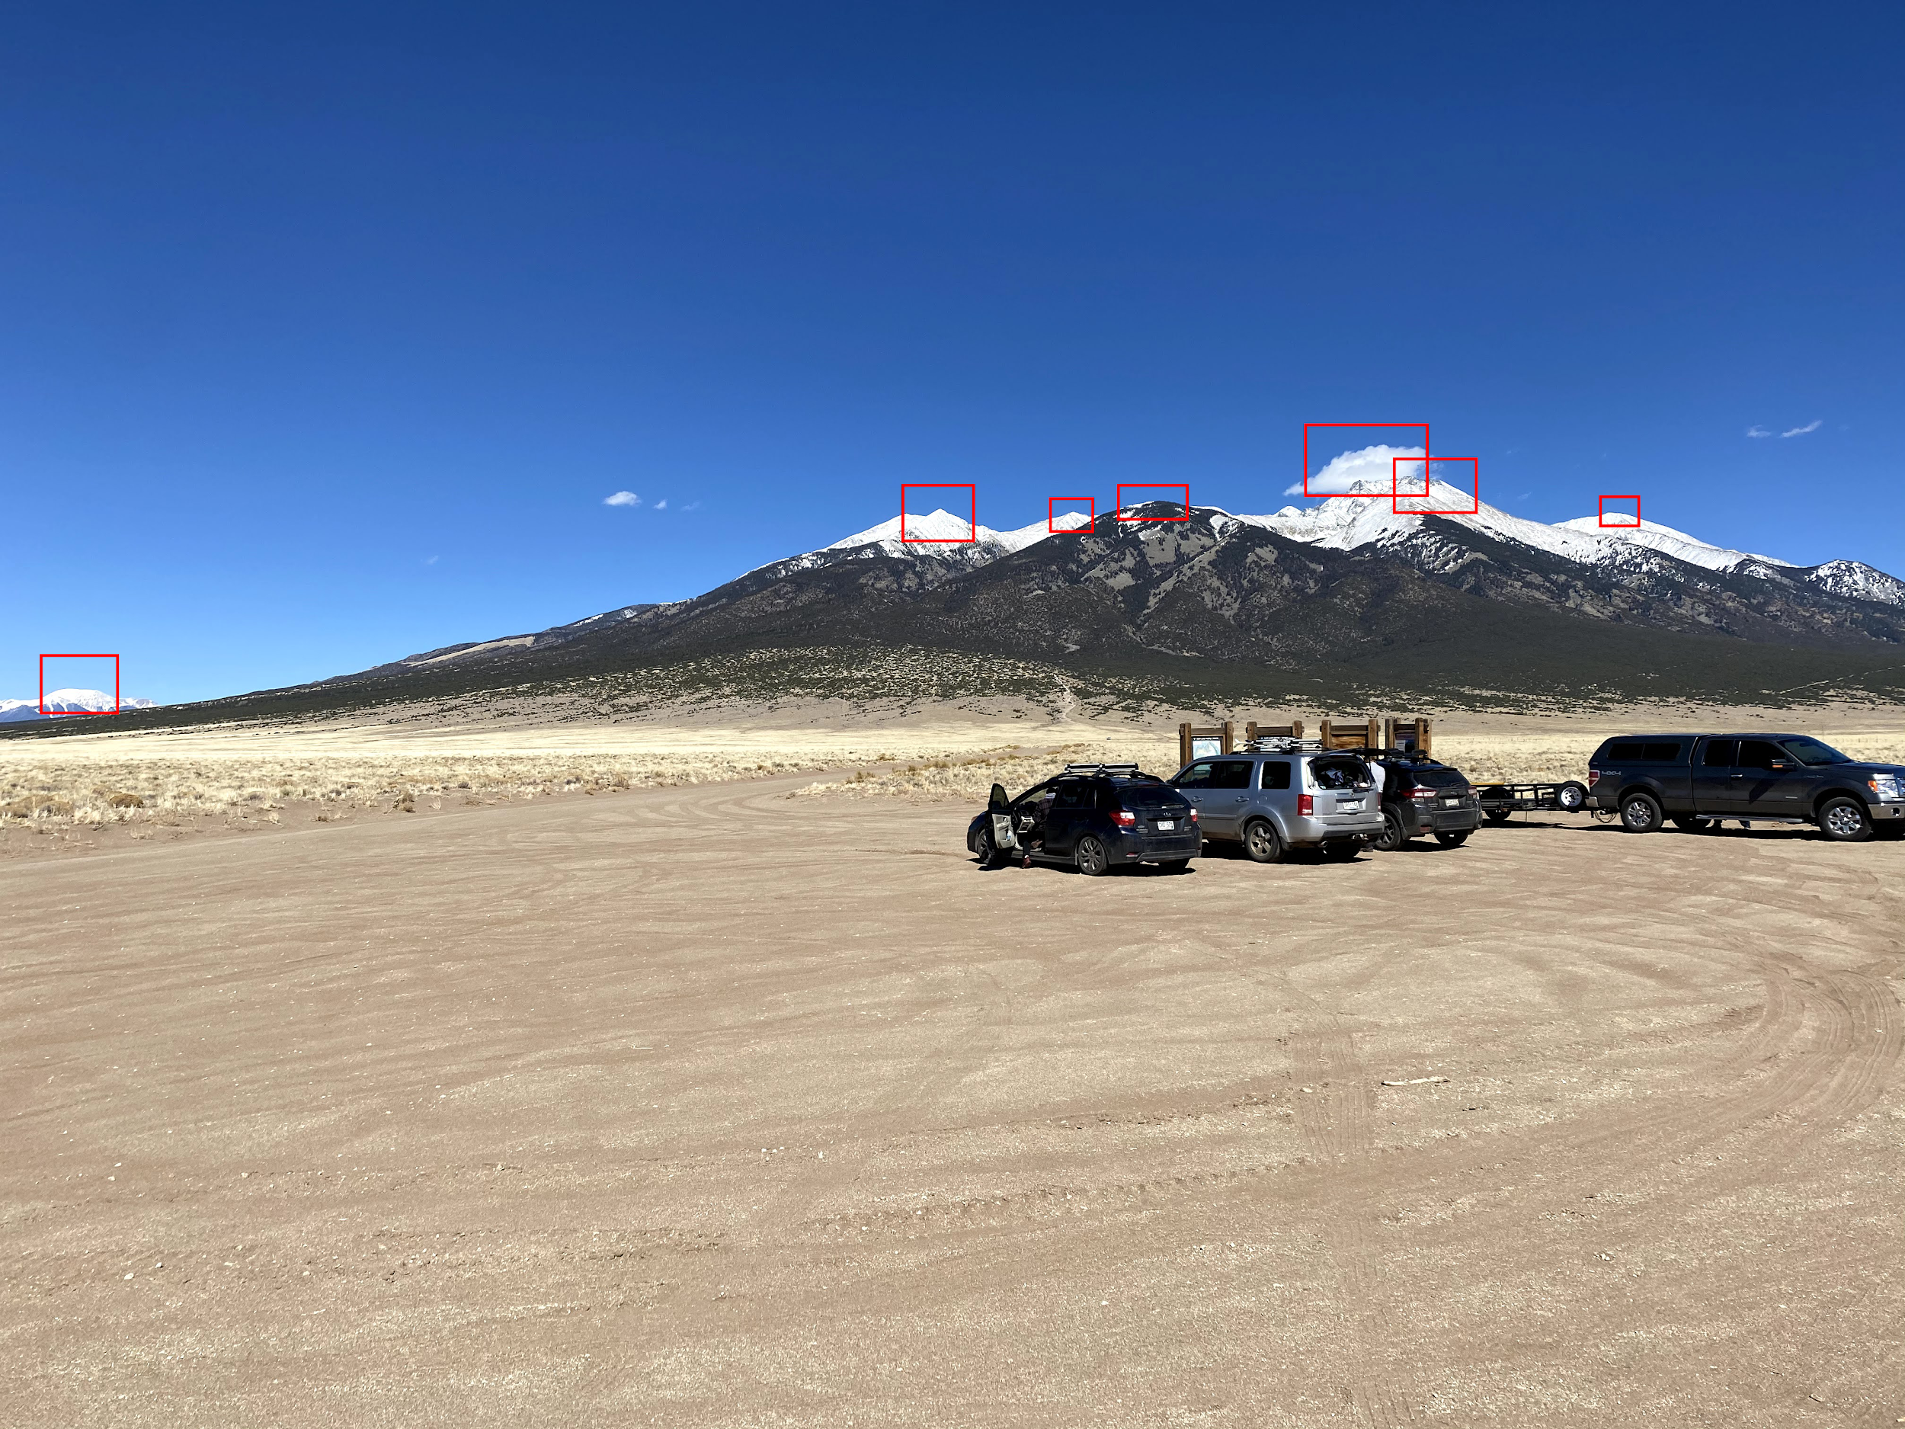
Remaining Work - to be completed by December 14th
Export trained FR-CNN network for peak identification
Match model output to expected peaks in FoV
Stitch together complete pipeline
Output Annotated Images
Notes:
BEN END

Slide 16
Limitations & Possible Future Work
Limitations
GPS Ethics
Photos not containing enough information
Peak Discrinmination
Not all peaks are on the horizon
Future Work
Streamlining into realtime AR
Expanding Dataset
Notes:
Nam
GPS EXIF Data Ethics: What we shouldn’t do. (https://arxiv.org/ftp/arxiv/papers/1703/1703.09827.pdf)
“””
We are working on the connections between isolated photos where no serial number is provided. An issue could be the legal implications - what kind of information can we store and work on. Is the picture considered to be personal information, or can it be just be linked to the device (and not to the person) as we consider that the brand, model of the device is not personal information. This opens up new perspectives for investigators.
“””

Slide 17
Questions

Slide 18
References
[1] Podobnikar, Tomaž. (2012). Detecting Mountain Peaks and Delineating Their Shapes Using Digital Elevation Models, Remote Sensing and Geographic Information Systems Using Autometric Methodological Procedures. Remote Sensing. 3. 784-809. 10.3390/rs4030784.
[2] Graphical line of sight. https://pypi.org/project/geographic-line-of-sight/
[3] PeakFinder App, https://www.peakfinder.org/mobile/
[4] https://www.sota.org.uk/Online-Resources

